Slide 1
REVELATION
LESSON THREE

Slide 2
THE THINGS HEREAFTER
CHAPTER FOUR

Slide 3
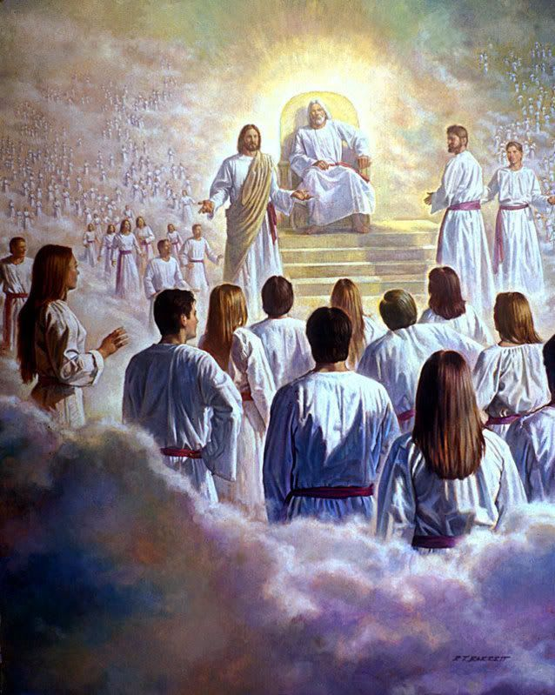
SEVEN THINGS AROUND THE THRONE OF GOD

Slide 4
THE TRIUNE GOD (2)
THE TWENTY-FOUR ELDERS (4)
THE SIGNS OF JUDGEMENT (5)
THE SEVEN SPIRITS OF GOD (5)
THE SEA OF GLASS (6)
THE FOUR LIVING CREATURES (6)
THE HEAVENLY WORSHIPERS OF CHRIST (11)

Slide 5
RAPTURE
The main Bible passage of the rapture of the church is 1Thessalonians 4:13-18, verse 17 tells us “then we who are alive and remain are caught up” this means to seize as a robber seizes his prize. The Latin word raptus from which we get our word rapture means to seize by force.
The sudden silent snatching away of believers

Slide 6
THE TRIUNE GOD (2)
THE TWENTY-FOUR ELDERS (4)
THE SIGNS OF JUDGEMENT (5)
THE SEVEN SPIRITS OF GOD (5)
THE SEA OF GLASS (6)
THE FOUR LIVING CREATURES (6)
THE HEAVENLY WORSHIPERS OF CHRIST (11)

